Slide 1
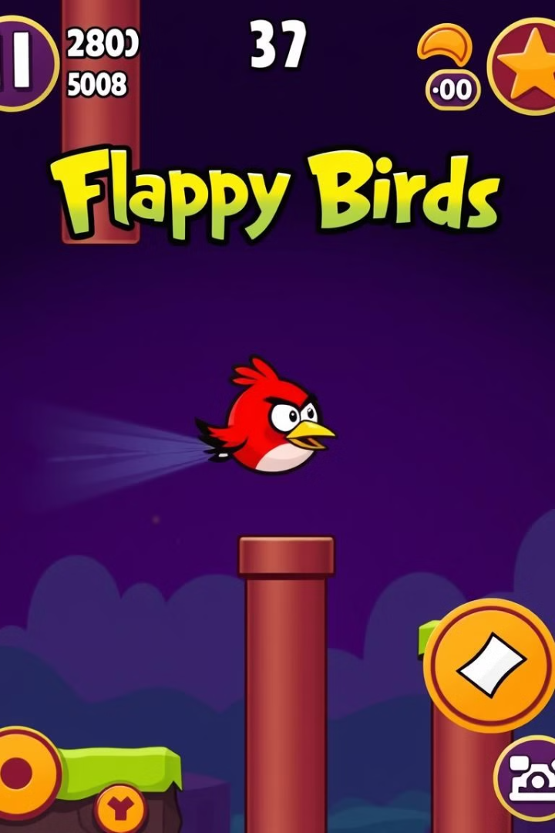
Reinforcement Learning for Flappy Bird
RL algorithms teach AI to play Flappy Bird game.
Compares Q-learning, SARSA, and Monte Carlo methods.
Nguyen Huong Giang – 22011105
22011105@st.phenikaa-uni.edu.vn
Notes:
Good morning everyone. Well come to my presentation.
Today, I am going to present our research on training an agent to play the game Flappy Bird using reinforcement learning techniques.
Flappy Bird is a simple yet challenging game, which makes it a great candidate for applying machine learning, specifically reinforcement learning.
Our goal was to see how well different algorithms could help an agent learn to play the game effectively, without any human intervention."

Slide 2
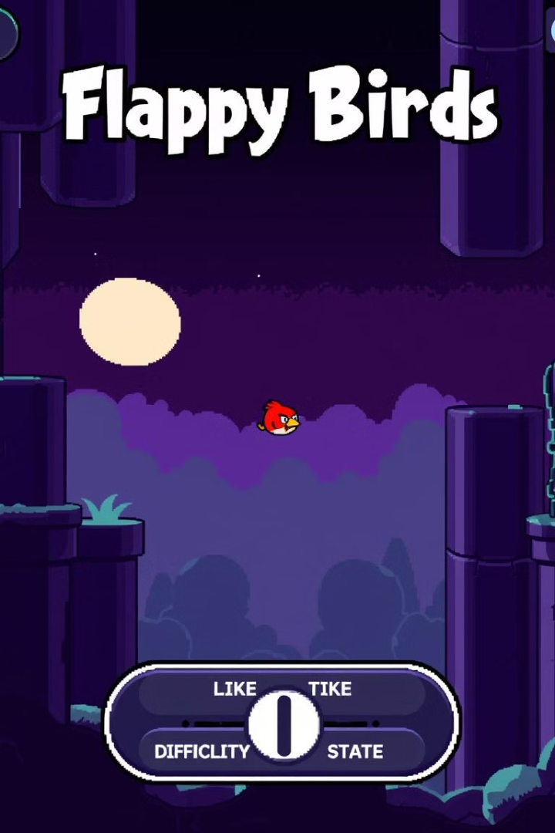
INTRODUCTION
1
Overview
Flappy Bird is a game where the player taps to control a bird, navigating through pipes without hitting them.
2
Problem Description
The challenge is to train an agent to play Flappy Bird autonomously. The agent must learn to make real-time decisions based on the bird's position, speed, and distance to obstacles, aiming to maximize the score.
3
Objective
This report compares various reinforcement learning algorithms, including
Q-learning, SARSA, Monte Carlo methods.
Notes:
"Let's start with a brief introduction to the project”.
1.1 Overview:
- In the game Flappy Bird, the player controls a bird and helps it navigate through pairs of pipes by tapping to make the bird jump.
- Every time the bird successfully passes a pair of pipes, the player earns a point.
- The game ends if the bird hits a pipe or falls to the ground.
1.2 Problem Description:
- The challenge here is to train an agent to play Flappy Bird without any human assistance.
- The agent must learn to make real-time decisions based on factors like the bird’s position, speed, and distance to upcoming obstacles.
- The ultimate goal is to maximize the agent's score.
1.3 Objective:
- In our study, we aim to compare different reinforcement learning algorithms: Q-learning, SARSA, Monte Carlo methods

Slide 3
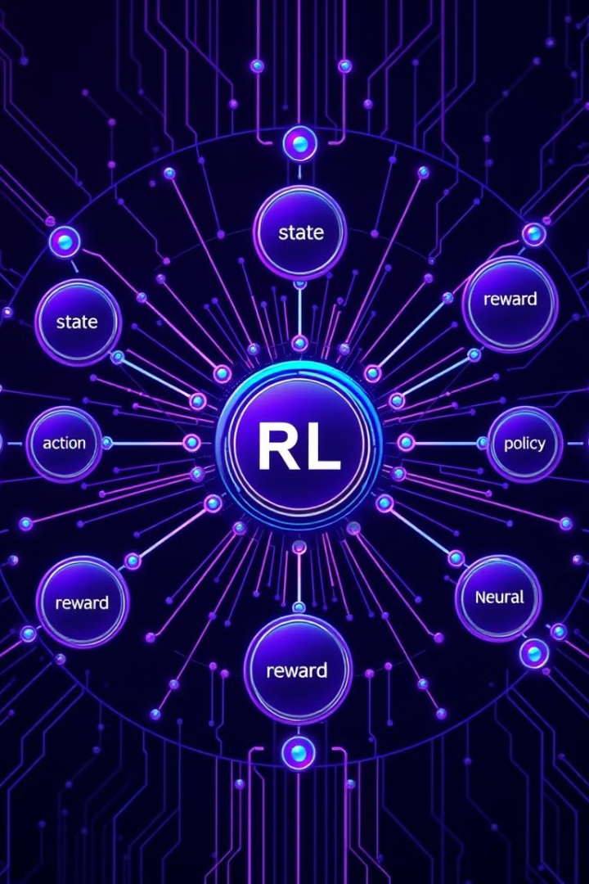
Reinforcement Learning Basics
1
State
Bird position, velocity, distance to pipes.
2
Action
Jump or do nothing.
3
Reward
The reward system gives the agent points for successfully
navigating through pipes..
4
Policy
The agent’s strategy for choosing actions based on the state.
Notes:
"Moving on to the theoretical background’.
2.1 Core Concepts of Reinforcement Learning:
Reinforcement learning is all about training an agent to make decisions that maximize its reward. Some of the key concepts include:
- State: This is the information about the current situation.
- Action: The actions available are simple—either the bird jumps or it does nothing.
- Reward: The reward system gives the agent points for successfully navigating through pipes.
- Policy: The agent’s strategy for choosing actions based on the stata.

Slide 4
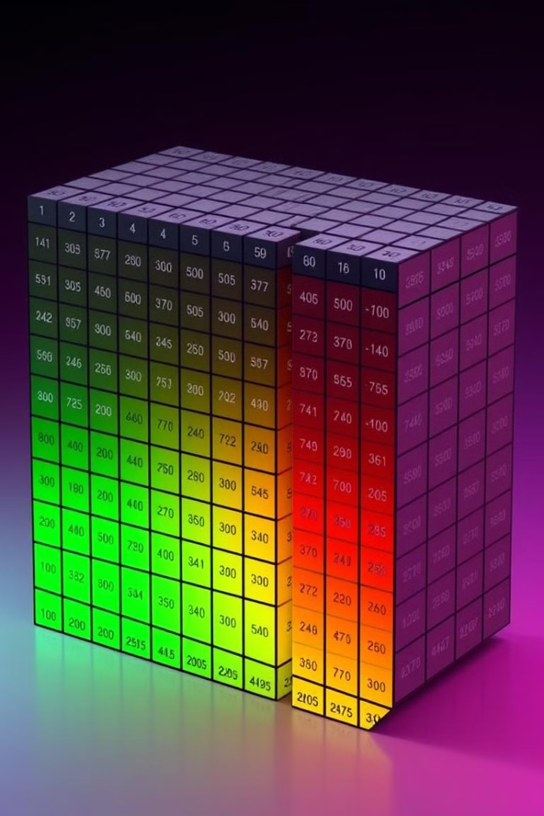
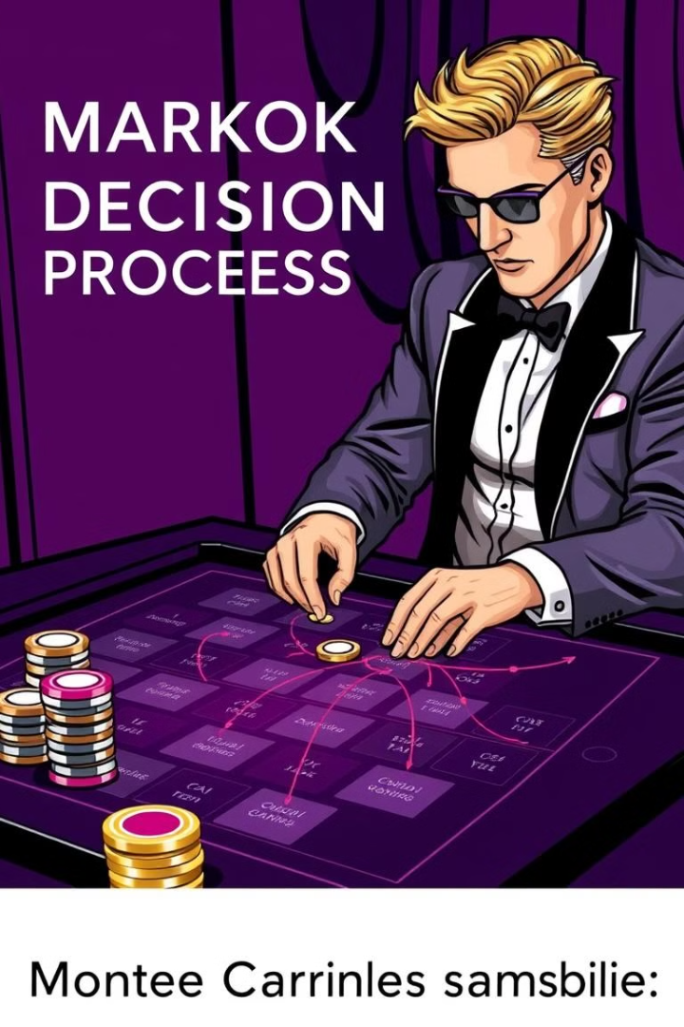
Q-Learning Algorithm
An off-policy method where the agent learns the optimal actions by updating Q-values for state-action pairs.
SARSA Algorithm
An on-policy method where the Q-value is updated based on the agent's actions, reflecting what the agent actually learns.
Monte Carlo Methods
These rely on complete playthroughs of the game to estimate the Q-values by averaging the accumulated rewards."
Notes:
2.2 Overview of Algorithms: We explored several reinforcement learning algorithms:
- Q-Learning: An off-policy method where the agent learns the optimal actions by updating Q-values for state-action pairs.
- SARSA: An on-policy method where the Q-value is updated based on the agent's actions, reflecting what the agent actually learns.
- Monte Carlo Methods: These rely on complete playthroughs of the game to estimate the Q-values by averaging the accumulated rewards.

Slide 5
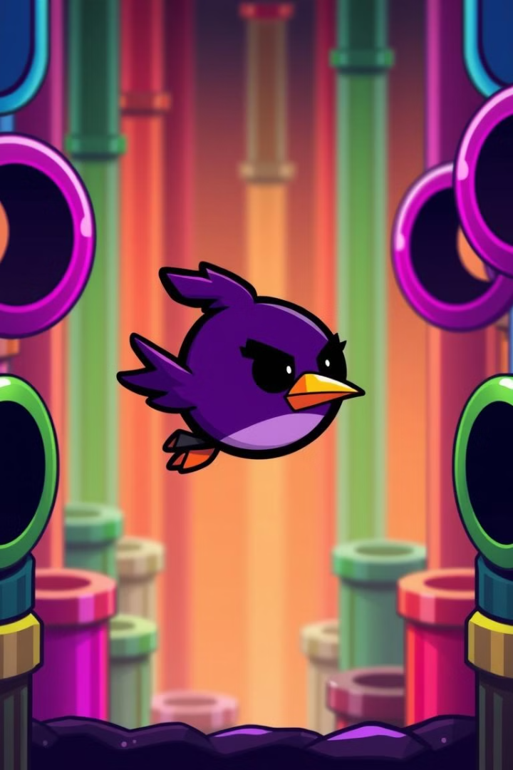

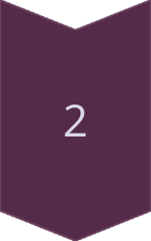
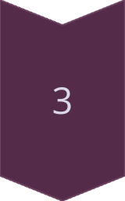
METHODOLOGY
Problem Definition
Define the state, action, and reward system for Flappy Bird.
The agent’s goal is to learn an optimal policy to survive as long
as possible.
Algorithm Selection
The selected algorithms are chosen based on factors like
ease of implementation, learning speed, and generalization
capability.
Implementation:
Develop a Flappy Bird game environment.
Apply algorithms like Q-learning, SARSA, and Monte Carlo
to train the agent.
Train and evaluate the agent by adjusting hyperparameters
for optimal learning.
Notes:
"Next, let's dive into our methodology”.
3.1 Problem Definition:
The main task was to train an agent to play Flappy Bird without human intervention. The key elements include:
- State: The game provides information such as the bird's position, speed, and the distance to the next obstacle.
- Action: The agent’s choices are to make the bird jump or let it fall.
- Reward: If the bird survives, it earns points. If it crashes, the game ends.
3.2 Algorithm Selection:
We chose algorithms based on criteria such as ease of implementation, learning speed, and how well they generalize to unseen scenarios. The selected methods were Q-learning, SARSA, and Monte Carlo.
3.3 Implementation: Our approach involved setting up a simulated game environment, applying the selected algorithms, and training the agent. Afterward, we evaluated and compared the performance of each algorithm.

Slide 6

EXPERIMENTAL SETUP
Environment Setup
Hyperparameter Tuning
Configure the Flappy Bird simulation to provide state inputs and allow actions by the agent. Adjust the frame rate and difficulty to test adaptability.
Adjust learning rate, discount factor, and exploration rate (epsilon) for algorithms to optimize learning.
1
2
3
Data Collection
Capture state-action-reward sequences during gameplay for updating models and analyzing performance.
Notes:
"Now, let's look at how we set up the experiments”.
4.1 Environment Setup: We configured a simulated Flappy Bird game environment to provide the necessary inputs and rewards. The environment could adjust the frame rate and difficulty to test the agent's adaptability.
4.2 Data: During the training process, we collected state-action-reward data. This allowed us to update the agent's models and analyze its performance across different game sessions.
4.3 Hyperparameter Tuning: Finally, we adjusted key parameters such as the learning rate, discount factor, and exploration rate (epsilon) to optimize the agent's performance. Proper tuning was crucial for the agent to learn effectively and maximize its score.

Slide 7




Conclusion and Future Work
Successful Implementation
All algorithms learn to play Flappy Bird effectively.
Performance Insights
Trade-offs between learning speed and final performance observed.
Future Directions
Explore deep RL methods for more complex games.
Notes:
- In conclusion, our study demonstrated that reinforcement learning algorithms can effectively teach an agent to play Flappy Bird by making real-time decisions.
- We found differences in performance between Q-learning, SARSA, and Monte Carlo methods, which highlighted the strengths and limitations of each approach.
- Moving forward, future work could involve testing more complex algorithms, refining hyperparameters, or applying similar methods to other games or real-world problems.
Thank you for your attention

